Slide 1
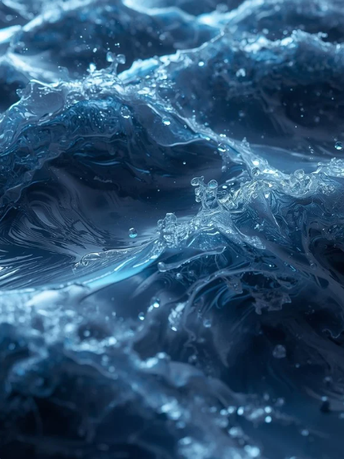
StormVision
GenAI-Based Person-in-Water Detection in Rough Seas
Presenter:
Tomer Atia, Shalev Cohen, Noam Hadad

Slide 2

Project Review - StormVision - Interim
Goal: Detect a person in water from aerial drone images and evaluate robustness under calm-to-storm sea conditions using synthetic data
Input & Output
What changed from the proposal
Novelty / contributions
Added synthetic storm data generation using Stable Diffusion + ControlNet (inpainting with object-preserving masks)
Introduced pair-aware dataset design (ORIG vs SYNTH image(
Changed the problem formulation from image classification to object detection (bounding boxes + confidence)
Input: Drone RGB image (real calm-sea + synthetic storm-sea)
Output: Bounding Boxes (location) and Confidence Scores (probability).
Built a paired real-synthetic storm dataset for person-in-water detection
Introduced pair-aware evaluation to directly measure robustness degradation
Demonstrated that fine-tuning with synthetic storm data improves detection robustness under severe sea conditions

Slide 3
Related Work (Previous Work)
# | Paper / Year | Task | Method & Data | Key Findings & Limitations | Relevance to My Project
1 | SeaDronesSee (2022) [reference] | Human detection in open water | 54K frames (YOLO / R-CNN) | Finding: Small humans are hard to detect. Limit: No rough-sea conditions. | Serves as the main dataset we extend with GenAI rough-sea augmentation.
2 | Person-in-Water Detection (2024) [reference] | Detect people for SAR | 72K frames, YOLOv4 | Finding: Accuracy drops in unseen environments. Limit: Lacks extreme sea states and extreme weather. | Shows that person-in-water detectors fail under unseen conditions, directly motivating our calm-to-storm robustness evaluation
3 | SafeSea (2024) [reference] | Generate synthetic harsh sea states | Latent Diffusion (Sea editing) | Finding: Rough-sea augmentation improves robustness. Limit: Not focused on "person-in-water". | The conceptual foundation for our GenAI sea-state augmentation approach.

Slide 4
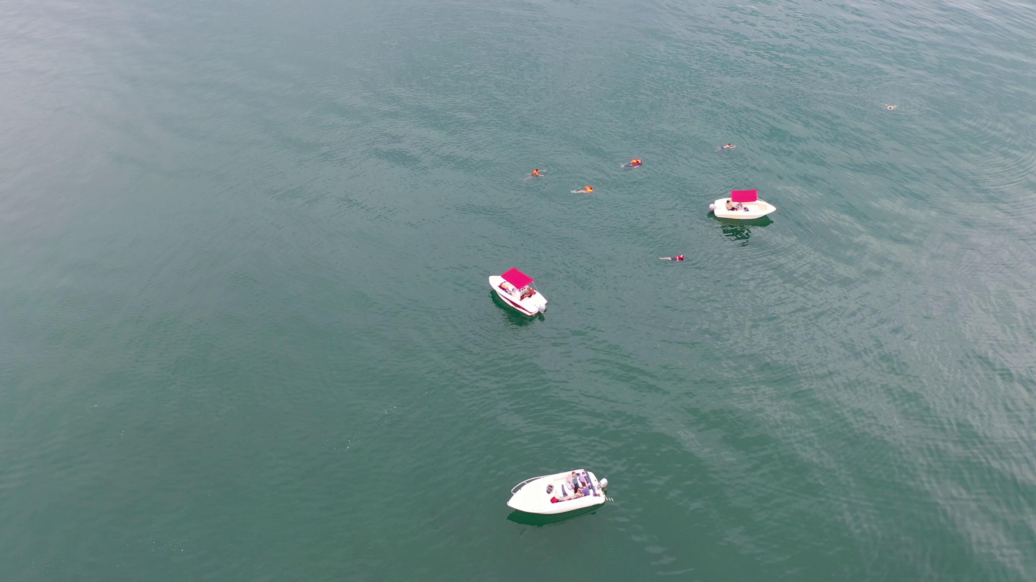
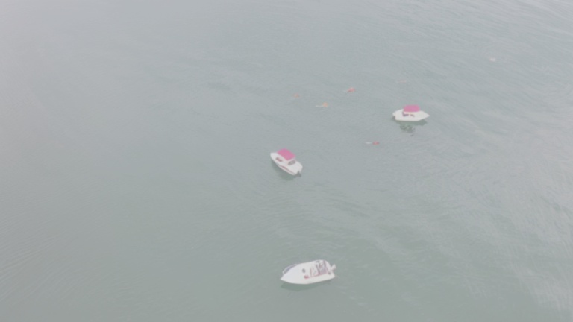
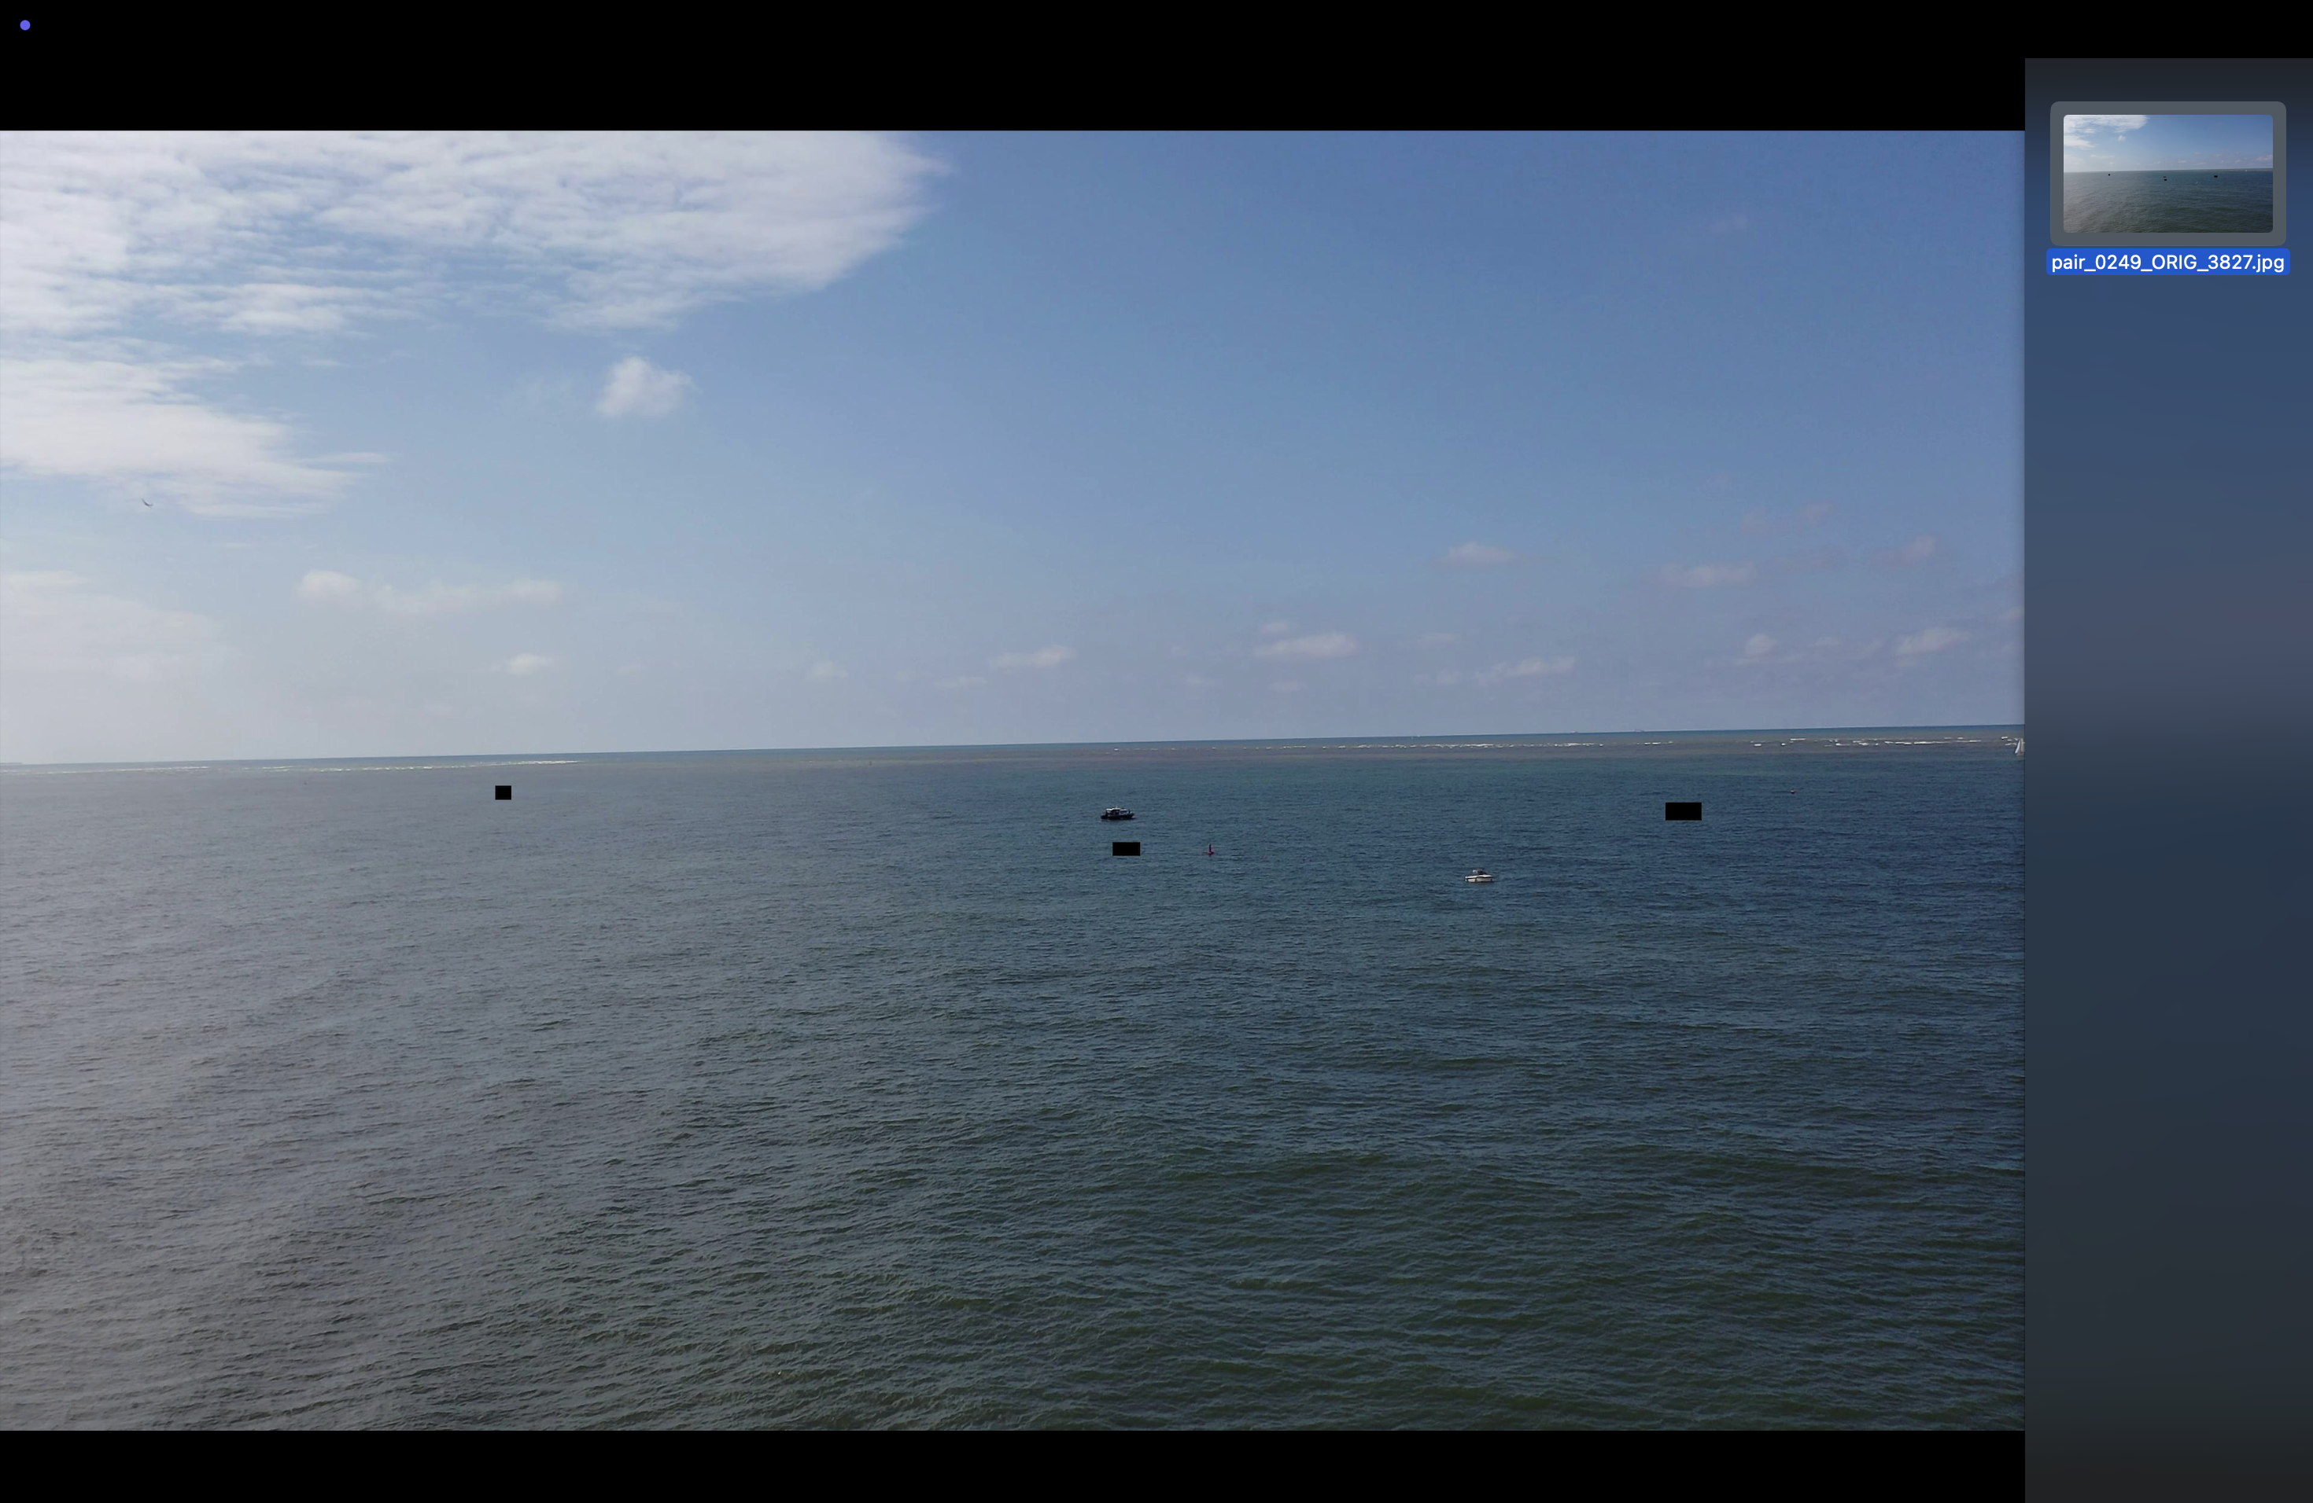
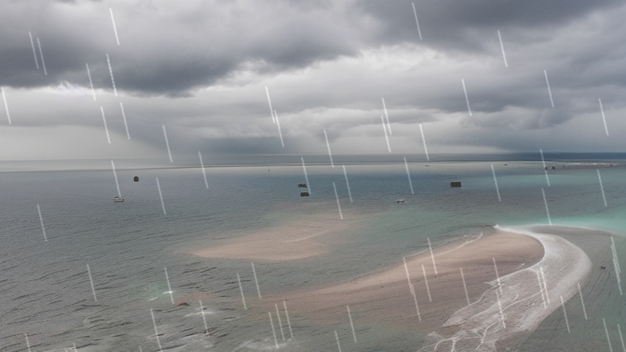
Examples Synthetic generation :

Slide 5
Dataset + EDA (300 samples)
Data generation
Dataset
Total Volume: ~600 Images (300 Original + 300 Synthetic).
Positive Samples: 450 Images
Contain labeled objects (People / Boats).
Negative Samples (Background): 150 Images
"Empty" stormy sea (No objects).
Crucial for reducing False Positives.
Inpainting: Uses automated masks to protect people and boats, changing only the weather around them.
Structure Preservation: Uses ControlNet to lock the image outlines.
EDA highlights Original Dataset (SeaDronesSee)
Tiny Objects: Targets (Persons) occupy <1% of the image pixels, making detection difficult.
Background Dominance: Images are 95%+ water, creating a high signal-to-noise ratio.

Slide 6
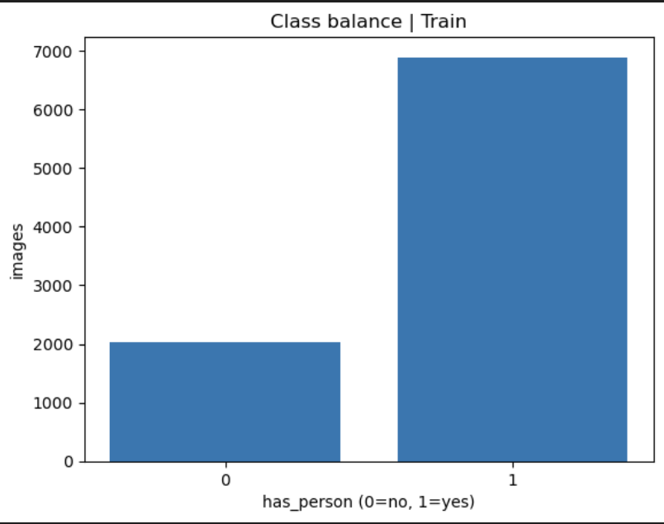
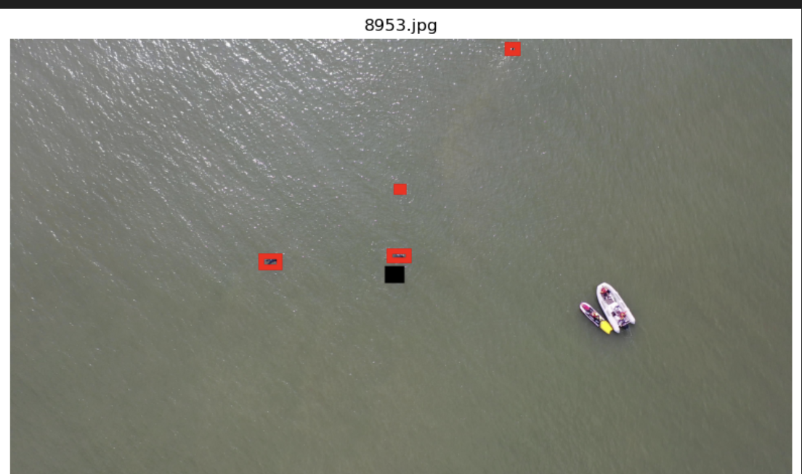

Slide 7
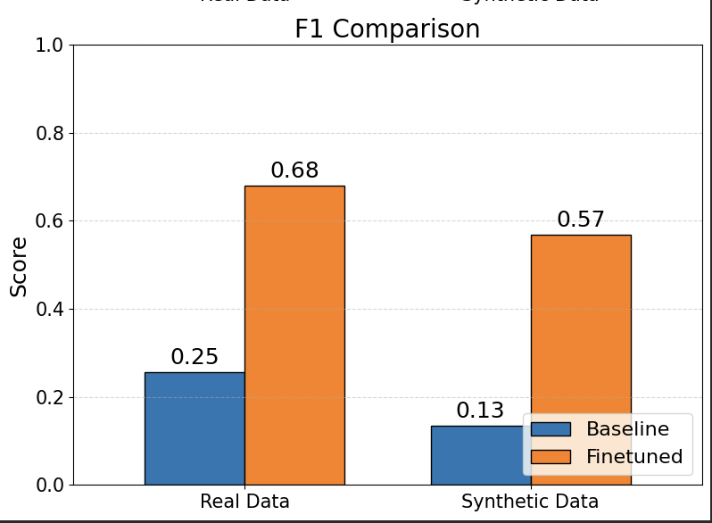
Baseline Solution and Results
Baselines
Results
Model A (Baseline): Standard YOLOv8s pre-trained
Model B (Finetuned): Fine-tuned on our hybrid dataset (Real + Synthetic) to master detection in storm conditions.
Higher Recall: Significantly improved detection of small targets in storm conditions.
Weather Resilience: Successfully detects objects through rain and fog, outperforming the baseline.

Slide 8
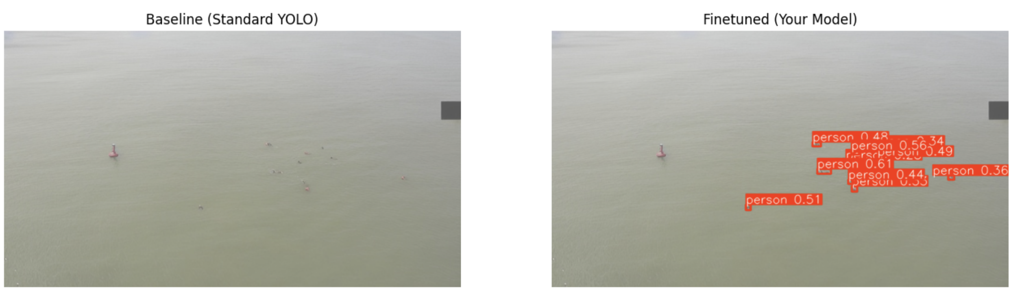
Baseline Model vs Finetune Model

Slide 9
Plan (Roadmap to Final Project)
Week | Phase Focus | Key Tasks (StormVision Specifics) | Weekly Deliverable
1 | Data-Centric Optimization (Refining the input) | Hard Negative Mining: Generate additional "empty sea" images (specifically with heavy foam/whitecaps Extreme Scenarios: Create a small batch of edge cases (e.g., night/low-light, heavy fog mix) to test robustness. | v2_synth_dataset (Enhanced & Cleaned)
2 | Model-Centric Optimization (Tuning & Training) | Architecture Comparison (Optional): Train YOLOv8m (Medium) alongside the current Small version | Final best.pt Model
3 | Evaluation & Analysis (Visualizing Results) | Evaluation & Analysis | Final Results & Graphs
4 | Delivery & Presentation (Packaging) | Repository Cleanup: Organize code, upload datasets, and write a detailed README.md (Motivation, Pipeline, Results). Visual Abstract: Create one high-level diagram summarizing the Input -> Hybrid Pipeline -> Output. Final Presentation: Prepare the 5-slide deck: Motivation, Novelty, Methodology, Results, and Conclusions. | Final Submission (GitHub Repo + PPT/PDF)

